Slide 1
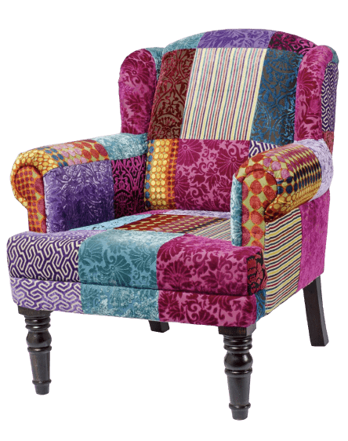
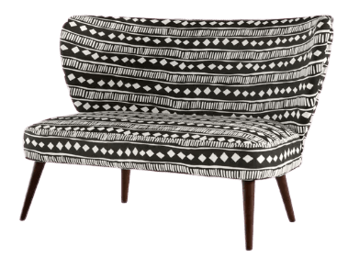
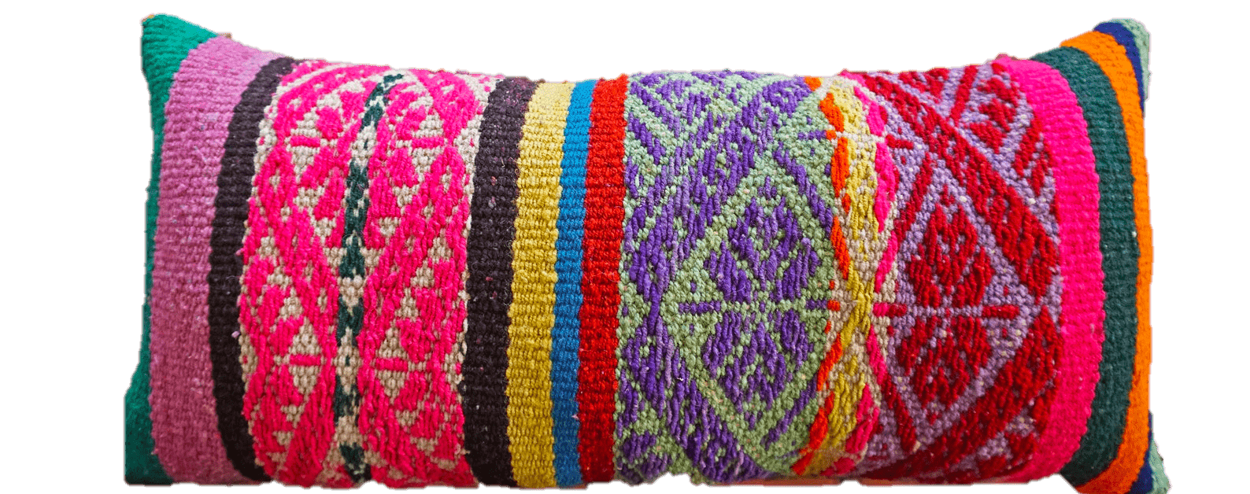
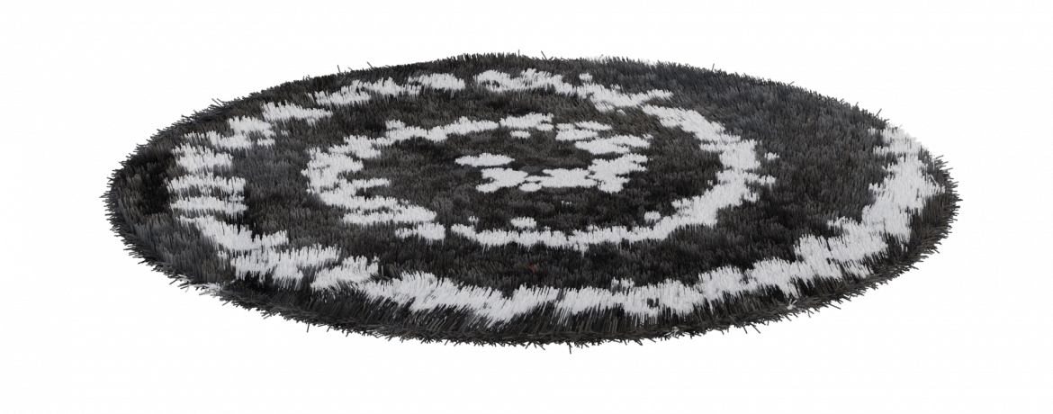
Welcome!
This week’s theme:
A Book (every other) Day Keeps Imagination at Play
Click to listen

Slide 2
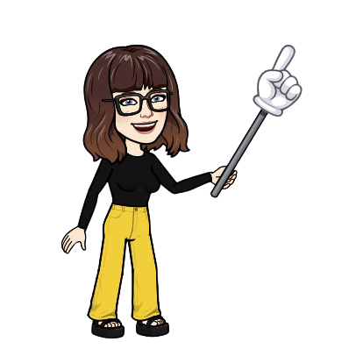
Rules
Chat
Kind
Mute
Wave hand
Try

Slide 3
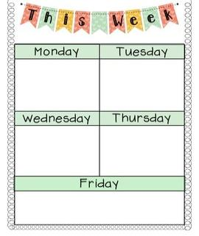
Artist Connections & Demonstration
Demonstration
& Work Time
Flipgrid Feedback & Work Time

Slide 4
Thursday
Click to watch

Slide 5
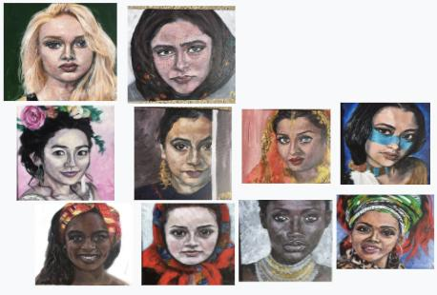
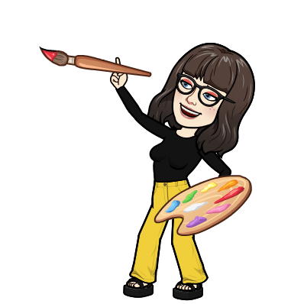
Click to see more
Ellen
Kaufman

Slide 6
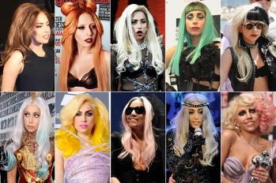
Click to listen
Lady Gaga - Hair
“I just wanna be free, I just wanna be me
And I want lots of friends that invite me to their parties
Don't wanna change, and I don't wanna be ashamed
I'm the spirit of my hair, it's all the glory that I bear”

Slide 7
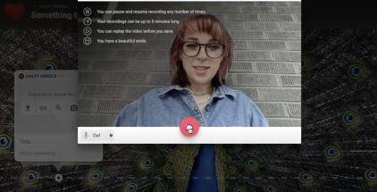
Click for directions

Slide 8
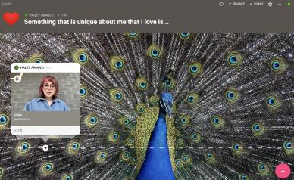
Click to add to Padlet

Slide 9
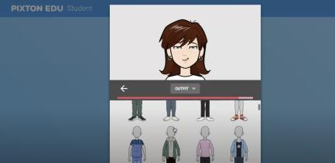
Click for instructions

Slide 10
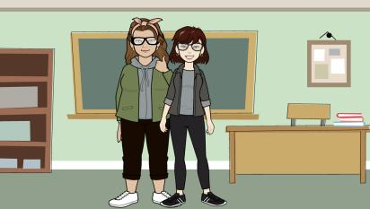
Click to join the class!

Slide 11
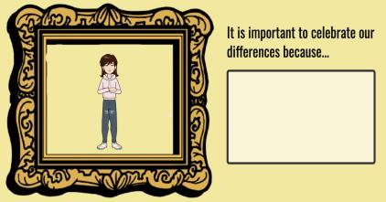
Click for instructions

